Slide 1
Large Language Models for Gen AI
Dr. Monali Mavani

Slide 2

Large Language Models for Gen AI
Disclaimer and Acknowledgement
The content for these slides has been obtained from books and various other source on the Internet
I here by acknowledge all the contributors for their material and inputs.
I have provided source information wherever necessary
I have added and modified the content to suit the requirements of the course

Slide 3
Agenda
Prompt Components & Design
Prompting Paradigms: Zero-shot, Few-shot. In-Context Learning
Structured Reasoning : Chain-of-Thought (CoT), ToT, Self consistency
Iterative Reasoning : ReACT, Self-Reflection / Critique
Prompt Engineering as System Design : Prompt Chaining & Control Flow, Query Decomposition, Routing / Query Classification, Function-Calling
Structured Data Handling
  Input — Handling Tables with LLMs (serialize / image / query)
  Output — Verification, Structured Generation, Constrained Decoding
Automated Prompt Optimization
Test-Time Compute Scaling
Context Engineering

Slide 4
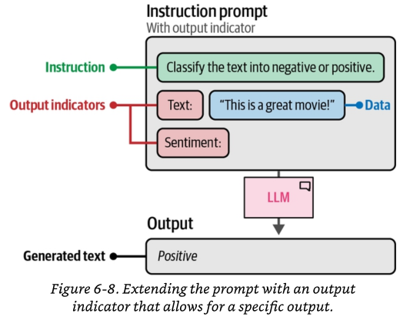
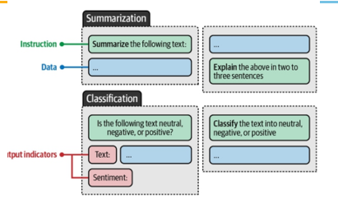
Instruction prompting
Instruction tuning is what made instruction prompting work. Base models don't reliably follow instructions. We fine-tuned them specifically to follow natural-language instructions. Because of that tuning, you can now just tell the model what to do in plain language — that act of telling is "instruction prompting." The technique exists only because the models were trained to make it work.

Slide 5
Anatomy of a Well-Engineered Prompt
Role / Persona
Instruction / Task
Context
Who the model should be — sets tone, expertise, vocabulary. “You are a senior tax consultant…”
What to do, precisely: classify, extract, rewrite, compare. One primary task per prompt
Background the model needs: domain facts, retrieved documents, conversation state, constraints
Examples (Shots)
Output Format
Input Data
Input → output demonstrations that define the task by example (few-shot / in-context learning)
Schema, length, language, JSON keys, allowed labels — makes output machine-consumable
The actual item to process — clearly delimited (XML tags, triple quotes) so it is never confused with instructions

Slide 6
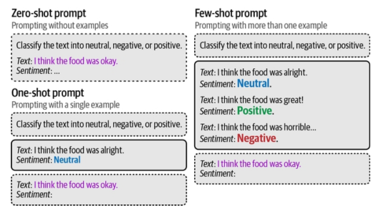
Zero-Shot vs Few-Shot Prompting
GPT-3 result (Brown et al., 2020): a 175B model with k=32 examples in the prompt rivalled fine-tuned models on many benchmarks — no gradient updates, “learning” happens in the forward pass
Few-shot helps most when the task format is unusual or labels are ambiguous; it helps least when the model is already instruction-tuned for that exact task
Cost: those examples are reprocessed on every request
Mitigation: prompt caching reuses the examples' KV-cache, so structure the prompt with stable content (examples) first, variable content (query) last

Slide 7
In-Context Learning — What Is Actually Happening?
In-context learning means the model adapts to a new task using only the examples in the prompt — its weights never change. The model isn't "learning" in the training sense; the examples simply steer the frozen model into the right behaviour for this task, for this one request.
ICL is surprisingly sensitive to how you present the examples. Three well-documented biases:
  Example order — the same examples in a different order can change the answer.
  Recency bias — the last example carries extra weight, nudging the model toward its label.
  Majority-label bias — if most examples share one label, the model over-predicts that label.
In practice: select examples by semantic similarity to the current query (retrieve the most relevant shots rather than using fixed ones), and keep formatting identical across all examples. These two choices dominate accuracy.

Slide 8
Chat template
Roles examples
  “user” for messages sent by the user
  “assistant” for messages sent by the model
  “system” sent at the beginning of the conversation and include directives about how the model should behave in the subsequent chat
Role information is usually injected by adding control tokens between messages, to indicate both the message boundary and the relevant roles
different models have been trained with wildly different formatting and control tokens for chat hence chat templates are defined
Chat conversations as a list of dictionaries, contains role and content keys, and represents a single chat message
  {"role": "user", "content": "Hello, how are you?"}
  {"role": "assistant", "content": "I'm doing great. How can I help you today?"}
  {"role": "user", "content": "I'd like to show off how chat templating works!"}

Slide 9
apply_chat_template() - Local Model Inference
messages = [
{"role": "system", "content": "You are a helpful assistant"},
{"role": "user", "content": "Hello!"}
]
# Convert to model-specific format
prompt = tokenizer.apply_chat_template(
messages,
tokenize=False,
add_generation_prompt=True
)
# Then tokenize and generate
inputs = tokenizer(prompt, return_tensors="pt")
outputs = model.generate(**inputs)
Formats conversation messages into the proper string format expected by a specific model's training.
Method on the tokenizer object
Used with locally loaded models (via transformers)
Converts structured chat format to model-specific prompt string
Each model has its own chat template (Llama uses different format than Qwen or Mistral)
Returns a formatted string or tokenized input
Requires manual generation call afterward

Slide 10
chat_completion - API-Based Inference
OpenAI-compatible API endpoint for hosted model inference
Used with hosted models (Inference API/Endpoints)
Follows OpenAI's chat completion format
No local resources: Doesn't require GPU/RAM for model
Faster setup: No model download/loading time
Scalability: Can handle many concurrent requests
Simpler code: No tokenization/generation logic needed
from huggingface_hub import InferenceClient
client = InferenceClient(token="hf_****")
completion = client.chat_completion(
model="meta-llama/Llama-3.1-8B-Instruct",
messages=[
{"role": "system", "content": "You are helpful"},
{"role": "user", "content": "Hello!"}
],
max_tokens=100,
temperature=0.7
)
print(completion.choices[0].message)

Slide 11
Delimiters
Delimiter Type | Syntax | Primary Use | Example
Triple Quotes | """...""" | Text blocks, paragraphs | """Summarize this text..."""
Triple Backticks | ```...``` | Code blocks | ```python code here```
XML Tags | <tag>...</tag> | Semantic sections | <context>...</context>
Square Brackets | [LABEL]...[/LABEL] | Named sections | [CONTEXT]...[/CONTEXT]
Curly Braces | {...} | Variables, placeholders | {user_input}
Angle Brackets | <...> | Placeholders | <insert name here>
Triple Dashes | --- | Section separators | ---
Triple Hashtags | ### | Headers, section titles | ### Instructions
Double Hashtags | ## | Sub-sections | ## Step 1
Pipes | ` | ` | Column separators
Asterisks | *...* | Emphasis, bullets | * Item 1
Equal Signs | === | Strong separators | ===
Greater Than | >>> | Nested content | >>> quoted text

Slide 12
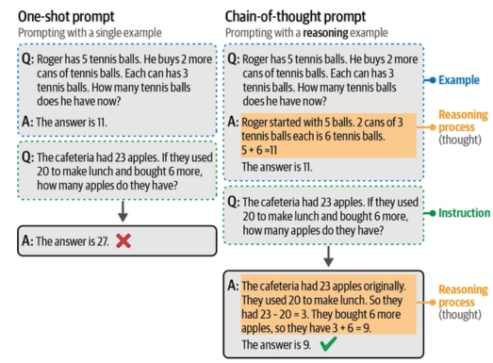
Chain-of-Thought: Think Before Answering
Few-shot CoT: demonstrations include the intermediate reasoning, not just the answer — the model imitates the reasoning pattern at test time.
Where CoT helps: math, logic, multi-step QA, planning. Where it doesn’t: simple retrieval/classification — it adds cost and can even distract.

Slide 13
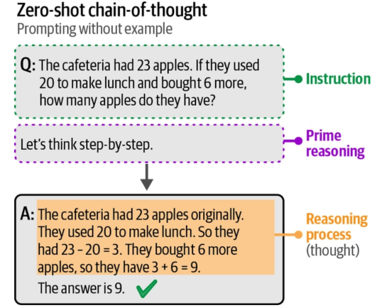
Zero-shot chain-of-thought
Chain-of-thought prompting without using examples. Instead, it uses the phrase “Let’s think step-by-step” to prime reasoning in its answer.
Alternatives
“Take a deep breath and think step-by-step”
“Let’s work through this problem step-by-step.”

Slide 14
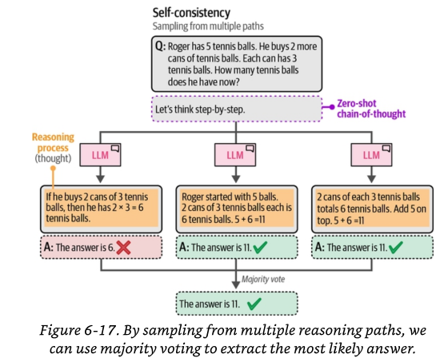
Self-Consistency: Improving Outputs via Multiple Samplings
Generate same prompt multiple times with sampling enabled, collect all outputs, and use majority voting on final answer.
Process (3 steps)
  Sample N outputs from the same prompt
    Use `temperature > 0` and `do_sample=True` to introduce variability
  Extract final answers from each sample
    Parse the answer from each output (e.g., regex to find numbers)
  Majority voting: pick the answer that appears most often

Slide 15
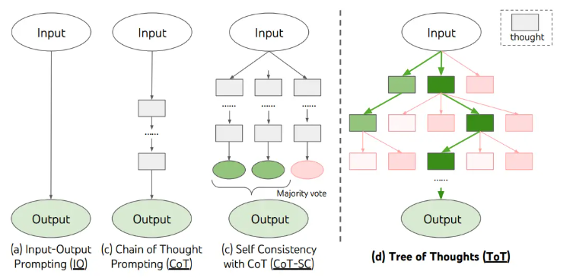
Tree of Thought Prompting
.
Why linear reasoning isn't always enough
CoT produces ONE reasoning path:
Step 1 → Step 2 → Step 3 → Answer
Tree of Thought
  Exploring multiple reasoning paths (like a search tree)
  At each intermediate step, generate multiple candidate thoughts (branches)
  Evaluate each candidate (which looks most promising?)
  Select the best candidates and continue expanding from them Prune unpromising branches to save computation
  Result: A tree of reasoning paths, not a linear chain

Slide 16
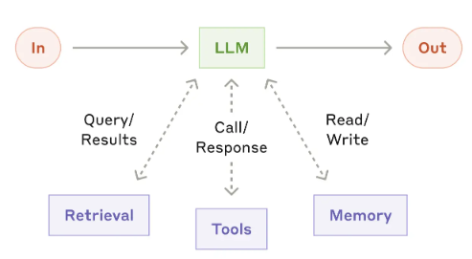
From Prompts to Pipelines
<-- Augmented LLM
Prompt as system component
Each LLM call does ONE job with ONE schema
Control flow (if/else, loops, retries) lives in code, not in the prompt
Every stage is independently testable & swappable (model per stage)
Observability: log inputs/outputs per stage
Prompt as artifact
One mega-prompt tries to do everything
Failures are opaque — which part broke?
Hard to test, version, or improve locally
Accuracy degrades as instructions pile up
Four design tools : chaining (sequential stages), decomposition (split the query), routing (pick the path), and function calling (let the model invoke code)
LangChain / LangGraph, LlamaIndex, DSPy — but the patterns are framework-independent
Image Source: https://www.anthropic.com/engineering/building-effective-agents

Slide 17
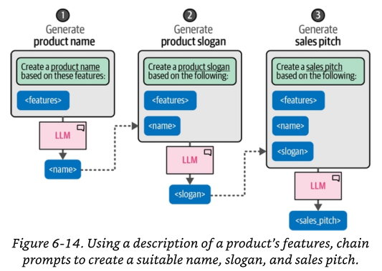
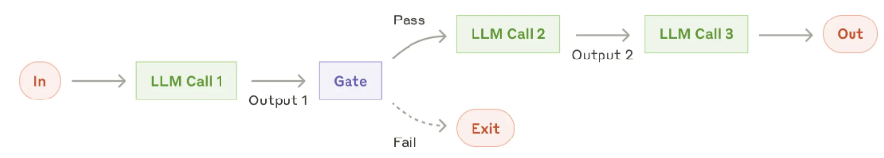
Prompt chaining
Breaking Problems into Sequential Steps
Traditional approach
  One complex prompt → One output
Each step in the chain is modular and independently debuggable
Ideal for situations where the task can be easily and cleanly decomposed into fixed subtasks
Add programmatic checks ( "gate” ) on any intermediate steps to ensure that the process is still on track.
Image Source: https://www.anthropic.com/engineering/building-effective-agents

Slide 18
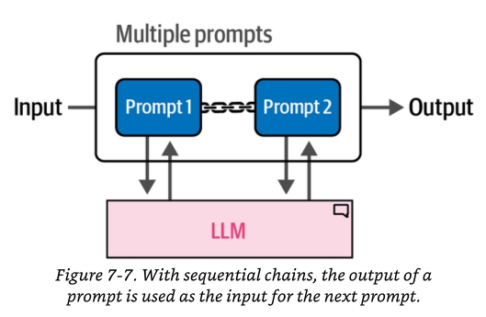
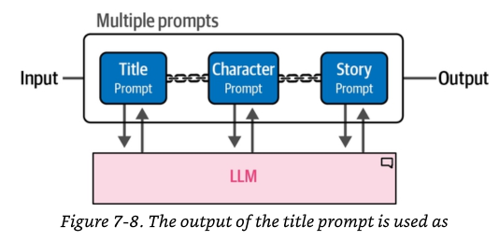
Chain with Multiple Prompts
Stage 1: Summarize
meeting transcript → minutes
Stage 2: Extract
minutes → action items (JSON)
Gate (code)
valid JSON? owners known?
Stage 3: Draft
items → follow-up emails
on failure: retry / re-ask (loop back)

Slide 19
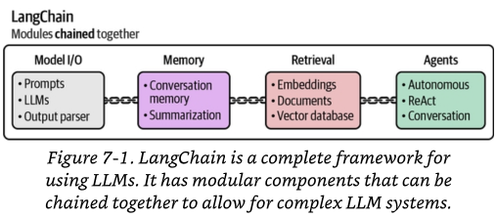
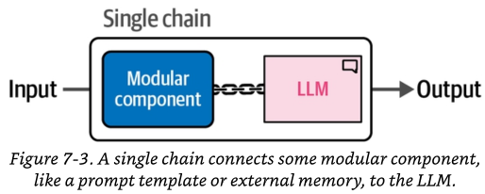
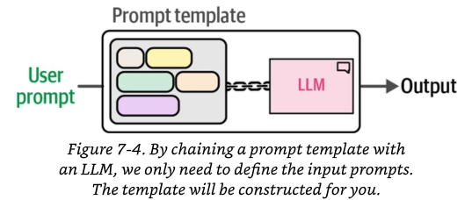
LangChain chain
Prompt chaining : sequence LLM steps so each output feeds the next. LangChain is one framework that implements it — a 'chain' is a reusable pipeline connecting a prompt, a model, and a parser

Slide 20
Query Decomposition — Divide, Solve, Recombine
Complex questions often fail in a single LLM call because they require multiple reasoning or retrieval steps.
Query decomposition breaks one hard query into smaller, answerable sub-questions.
Each sub-question is solved independently, then the answers are recombined into a final response.
In RAG systems, decomposition improves retrieval by turning one broad query into several focused ones
Least-to-Most prompting (Zhou et al., 2023): ask the model to first list sub-problems, then solve them in order, feeding earlier answers into later ones — enables easy-to-hard generalization
DECOMPOSER PROMPT → OUTPUT → PIPELINE
# CALL 1 — DECOMPOSER PROMPT
Break the question into 2-3 sub-questions
that can each be answered independently.
Output a numbered list only, nothing else.
Question: "Did Company A or Company B
grow revenue faster, FY23 to FY25?"
# CALL 1 OUTPUT → drives retrieval
1. Revenue of A in FY23 and FY25?
2. Revenue of B in FY23 and FY25?
3. Revenue of A vs Revenue of B?
# CALLS 2-4 — PIPELINE
Q1 → retrieve+answer ─┐
Q2 → retrieve+answer ─┼→ synthesize
Q3 ← uses Q1,Q2 answers ┘

Slide 21
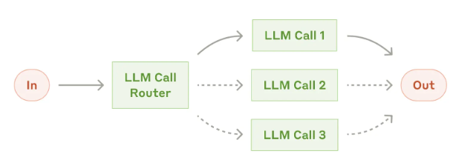
Routing / Query Classification
LLM-AS-ROUTER PROMPT
You are a router for a telecom assistant.
Classify the query into exactly one route:
- BILLING payments, invoices, refunds
- TECH connectivity, device, outage
- SALES new plans, upgrades
- HUMAN legal threats, churn risk,
anything you are unsure about
Return ONLY: {"route":"...",
"confidence":0.0-1.0}
Query: "Internet down since morning and
your app shows a bill for a closed account!“
→ {"route":"HUMAN","confidence":0.72}
A router is a cheap classifier in front of expensive paths: send each query to the right prompt, tool, index, or model.
Implementations: (a) LLM-as-router — a small/fast model with a classification prompt; (b) embedding/semantic router — nearest-route by cosine similarity (no LLM call); (c) fine-tuned classifier for high volume.
Routing dimensions: intent (billing vs tech), difficulty (small model vs reasoning model — cost routing), safety (escalate to human), data source (which index).
This workflow allows for separation of concerns, and building more specialized prompts.

Slide 22
Function-calling
Extend LLMs with custom capabilities by enabling them to call external functions based on natural language instructions + function descriptions and output a string that invokes that function
LLMs only generate function call strings—they don't actually execute them
Function Calling: LLM capability to generate function call strings
Tools: Actual functions being called by the LLM
Function Description: Text explaining what the tool does
Function Prototype: Function signature in the expected format (Python, JSON, etc.)
General-Purpose LLMs: Respond to all query types (including function calling)
Special-Purpose LLMs: Fine-tuned for specific tasks like function calling
  Example: NexusRavenV2-13B, gorilla-openfunctions-v2 (Based on Llama 3), functionary-small-v3.1 (based on Llama 3)

Slide 23
Tools – Functionality We Give the LLM
Standard LLMs are "Closed-Box" systems—they only know what they were trained on
Traditional LLM: "I think the weather in Paris is usually mild in May." (Stale Data)
Tool-Enabled LLM: "I don't know the current weather, but I see a get_weather tool. I will call it." (Real-time Data)
Tools are not "installed" into the model; they are described to it
Model decides if and when to use tools; your app executes them.
Example Tools
  get_weather — retrieve current weather for a location
  get_account_details — look up user account by ID
  issue_refund — process a refund for an order
  search_docs — query a knowledge base or database

Slide 24
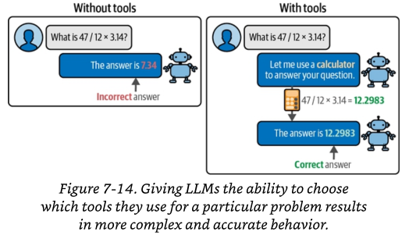
Tools – Functionality We Give the LLM

Slide 25
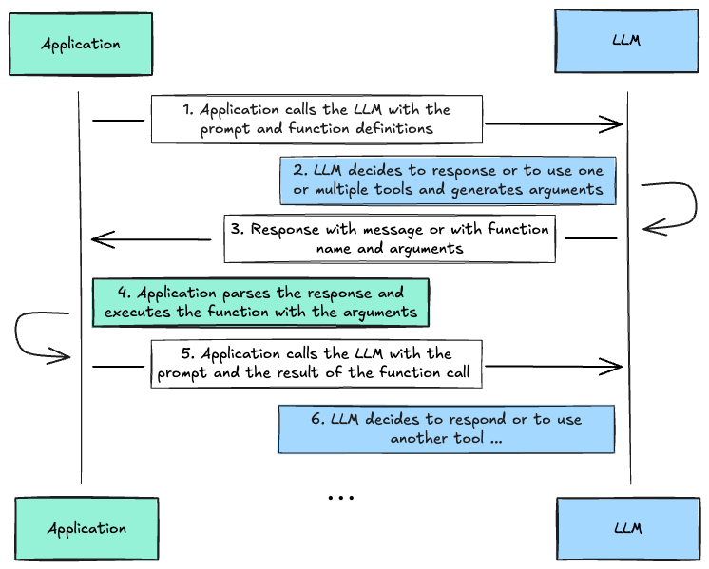
Function-calling
Using Tools (Function Definitions)
Tools are the primary way to define callable functions for your LLM. Each tool requires:
A unique name
A clear description
A JSON schema defining the expected parameters

Slide 26
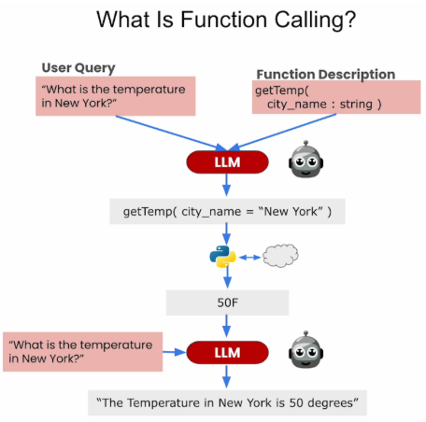
Function Calling Workflow
Step 1: Provide user query + function description to LLM
Step 2: LLM recognizes it can use the function to answer
Step 3: LLM generates executable function call string
Step 4: System executes the function
Step 5: Return results and original query to LLM
Step 6: LLM generates final answer
Figure credits : https://github.com/ksm26/Function-Calling-and-Data-Extraction-with-LLMs

Slide 27
Parallel function calling
Specialized capability where an LLM generates multiple tool requests in a single response
LLM outputs an array of tool calls in a structured format (usually JSON), e.g
{
"tool_calls": [
{
"id": "call_001",
"type": "function",
"function": { "name": "get_weather", "arguments": "{\"location\": \"London\"}"
}
},
{
"id": "call_002",
"type": "function",
"function": { "name": "get_weather", "arguments": "{\"location\": \"Tokyo\"}" }
}
]
}

Slide 28
Iterative reasoning
ReAct — Reasoning + Acting (Yao et al., 2023)
Thought
what do I need?
Action
tool call
Interleave three message types in a loop: Thought (free-form reasoning about what to do next), Action (a tool call: search, lookup, calculator, API), Observation (the tool’s result, appended to context).
Reasoning guides acting (decide what to look up); acting grounds reasoning (real evidence replaces hallucinated facts).
ReAct is the founding pattern of today’s tool-using agents
Observation
tool result
loop until Thought concludes “I now know the answer” → Final Answer
REAC T : SYNERGIZING REASONING AND ACTING INLANGUAGE MODELS

Slide 29
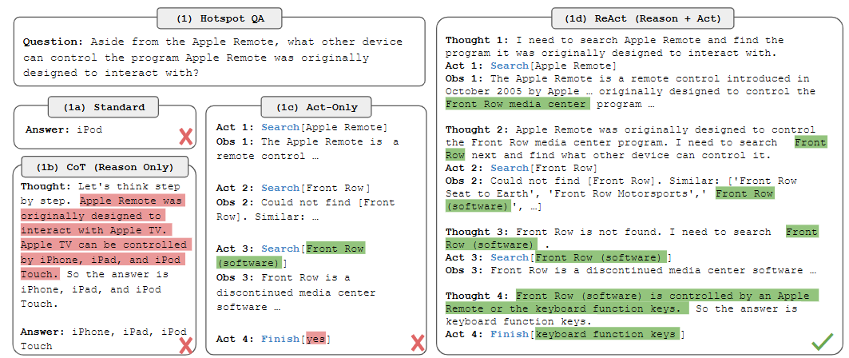
ReAct
REAC T : SYNERGIZING REASONING AND ACTING INLANGUAGE MODELS

Slide 30
Iterative reasoning
Step-Back Prompting
  Before answering, the model first derives the general principle or higher-level concept behind the question, then uses it to answer the specific case
Self-Reflection / Critique
  model reviews its own first output, critiques it, and produces a revised version, Expensive

Slide 31
Structured Data Handling
Input
  Tables → LLM (input): how do you get structured data into the model?
  Serialize, image, or query
Output
  LLM → JSON (output): how do you get structured data out of the model reliably? Manual, JSON mode, constrained decoding

Slide 32
Handling Tables with LLMs
A table isn't text. Before an LLM can use one, you choose how it enters the model, 3 paths
Serialize into the prompt
  Extract → render as text (Markdown / CSV / JSON / key-value) → put in prompt
  Best for: small tables the model must reason over as a whole
  Cost: the format choice affects accuracy and tokens
Feed as an image
  Skip extraction; hand the page/table image to a multimodal model
  Best for: messy, merged-cell, visually-complex tables
  Cost: higher token cost; no clean structured copy of the data
Query the table
  Extract to DataFrame / SQL → LLM writes code or SQL → sees only the answer
  Best for: large tables; specific facts or aggregates
  Cost: needs a tool/execution step,

Slide 33
Tabular Serialization — Feeding Tables to an LLM
SAME TABLE, THREE SERIALIZATIONS
LLMs read token streams — a table must be serialized to text. The choice of serialization measurably changes accuracy on table-QA tasks.
Markdown / pipe tables: compact, well represented in pretraining; good default for small-to-medium tables.
JSON records (row-wise dicts): verbose but robust — column–value binding is explicit, best when rows are processed individually.
CSV: cheapest in tokens but column alignment is implicit — errors grow with wide tables.
Practical rules: keep header row, prune unused columns, chunk long tables, and state units in headers (“revenue_inr_cr”).
# Markdown (good default)
| qtr | revenue_inr_cr | margin_pct |
|-----|---------------|------------|
| Q1 | 142.5 | 18.2 |
| Q2 | 156.1 | 19.0 |
# JSON records (explicit binding)
[{"qtr":"Q1","revenue_inr_cr":142.5,
"margin_pct":18.2},
{"qtr":"Q2","revenue_inr_cr":156.1,
"margin_pct":19.0}]
# CSV (cheap, fragile when wide)
qtr,revenue_inr_cr,margin_pct
Q1,142.5,18.2
Refs: Sui et al., “Table Meets LLM” (WSDM 2024); Fang et al., “LLMs on Tabular Data — a Survey” (arXiv:2402.17944); Singha et al., “Tabular Representation in LLMs” (2023).

Slide 34
Structured Output : Generate and Verify
GENERATION : enforcement during generation
VERIFICATION
parse / validate
applies to ANY method
User
input
Structured
output
Manual
JSON mode
Constrained
Method | Also called | Enforcement · grammar | Guarantee
Manual (prompt + parse) | Output Verification | After generation · no grammar | None
Fine-tuning | (training-based) | In the weights · training time | Soft — one format, costly to change
JSON mode | Structured Generation | During · generic JSON grammar | Valid syntax, not schema
Constrained decoding | Constrained Decoding | During · schema-specific FSM | Hard schema compliance
Constrain generation to guarantee the shape; verify output to guarantee meaning. Robust systems do both.

Slide 35
Output Verification
What to Check
How
Syntactic Does it parse at all? (valid JSON / expected format)
How: a parser, e.g. json.loads · deterministic
Deterministic (code)
fast · free · reliable
  Schema validation (Pydantic)
  Regex / pattern matching
  Type & range checks
  Whitelist / blacklist
Model-based (LLM)
for judgments code can’t express
  Self-verification
  Chain-of-Verification (CoVe)
  Verifier agent (separate model)
  LLM-as-checker
L1
L2
Schema / structural Right keys, types, enums, required fields?
How: JSON Schema / Pydantic · deterministic
L3
Semantic / business rules Are the values actually correct & safe? (dates in range, totals add up, IDs exist, content accurate)
How: coded rules where possible, else a model
Rule of thumb: push each check to the cheapest layer that can catch it — code before model. Constrained decoding already guarantees L1–L2, so verification then focuses on L3 (semantics).

Slide 36
Manual (prompt + parse)
"After generation · no grammar · Guarantee: None." And the lab's result is the honest advertisement of that row's "None" guarantee — even the best-structured prompt (delimited) still produced off-enum sentiment labels like "Neutral/Positive", because prompting is a request, not a constraint.
Component | Lab 1.2
Manual generation | The three prompt builders (prose, numbered, delimited) — all just ask for JSON in different structural styles. Nothing constrains the decoder
Verification (parse) | try_parse_json() — brace-match and json.loads()
Verification (validate) | is_reliable() / score_response() — check keys present, enums valid, order_number digits-only
Lab 1.2's try_parse_json is L1. is_reliable / score_response are L2 (keys present, sentiment in enum, urgency in enum, order_number digits-only). There's no L3 check in the lab — we never verify that the extracted product matches what the message actually names, or that the issue is faithful.

Slide 37
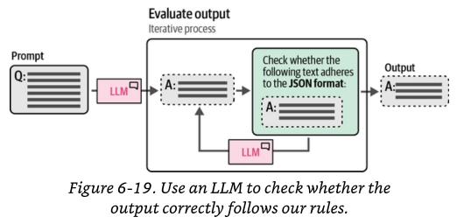
What to do when a check fails : Validate-and-Repair Loop
When a check fails, don’t discard the output — feed the error back. The validation message is itself a prompt, and a specific error repairs far better than “invalid, try again”.
pattern
  Generate the output from the LLM.
  Parse & validate against the schema (Pydantic).
  On failure, re-prompt with the exact error appended.
  Cap retries (e.g. 3 attempts).
  Still failing? Route to a fallback.
Works with any model — no special API
Latency only on failures (success = one call)
Layers on top of JSON mode or constrained decoding
Libraries: instructor · guardrails-ai · LangChain parsers.

Slide 38
Constrained decoding
Mechanism: compile the schema/grammar (regex, CFG, JSON Schema) into a finite-state machine over tokens. At each step, tokens that would leave the valid language are masked to −∞ before sampling.
Three main ways that a structured output can be defined for constrained decoding: regex, code (Pydantic models), and generative constructs.
Some recent models are already fine-tuned to incorporate these constraints inherently, reducing the need for extensive post-processing.
Example applications: automated content creation, data validation, and real-time language translation
When models are not inherently fine-tuned for constrained decoding, or when more precise control over the output is desired, dedicated libraries like LM Format Enforcer and Outlines provide tools to enforce specific constraints on model outputs

Slide 39
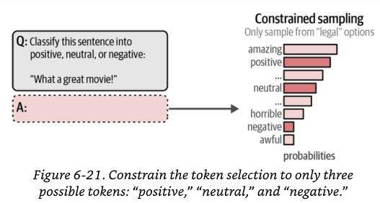
Grammar-Constrained Sampling
Restrict token generation to only grammar-valid sequences
Guarantees syntactically valid output (e.g., valid JSON, SQL)
Filter next-token distribution based on grammar at each decoding step

Slide 40
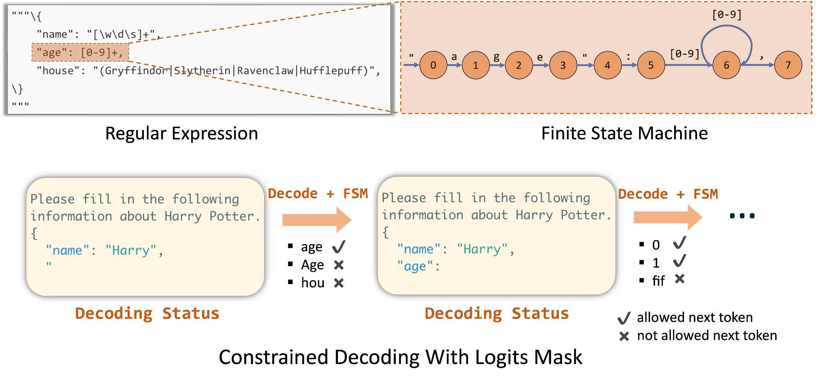
Constrained decoding
schema → regex → finite-state machine → token masking
https://www.lmsys.org/blog/2024-02-05-compressed-fsm/

Slide 41
Case Study — Customer-Support Copilot, End to End
FAQ chain
RAG over KB → grounded answer
User query
Router
small model, 4 routes
Verifier + formatter
schema check, tone, citations
Billing chain
tools: get_invoice, refund_status
Escalation
summary → human agent queue
Pattern | Blocks
Routing / Query Classification | Router block (4-way dispatch)
Function-Calling | Billing chain (get_invoice, refund_status)
Query Decomposition | Inside the billing chain (bill-higher → fetch → diff → explain)
Prompt Chaining & Control Flow | FAQ chain, Escalation branch, and the overall query→…→verifier flow
Structured Output Control | Verifier + formatter — cross-link to the other section

Slide 42
Automated Prompt Optimization
Instead of hand-tuning prompts — optimize them programmatically against a metric or labelled eval set. Prompts become parameters, tuned by data rather than intuition
APE — Automatic Prompt Engineer
  An LLM generates many candidate instructions, scores each on your eval set, and keeps the best one. Reference repo exists — in practice used via DSPy's MIPRO optimizer.
OPRO — Optimization by PROmpting
  The LLM acts as an optimizer: it proposes better prompts iteratively, using the scores of past attempts as feedback. Research code only — lives on as DSPy's COPRO optimizer.
DSPy / GEPA — the framework that operationalizes the above
  Declare the pipeline; it compiles and optimizes the prompts and few-shot examples automatically against your metric. MIPROv2 = current default optimizer; GEPA = the newer reflective one.

Slide 43
Test-Time Compute — Thinking Longer
Two ways to make a model better: the old way — a bigger model trained on more data — and a new way: let the model spend more compute thinking about each question, at answer time.
You set a thinking budget: more thinking gives better answers, but costs more time and money. You choose how much, per task.
Parallel — best of many
Ask the model several times, then pick the best answer. Easy to add — but you need a way to check which answer is right.
Sequential — one long think
The model writes one long reasoning trace — it plans, tries, catches its own mistakes, then answers. These are its “thinking tokens.”
Reasoning models (OpenAI o-series, Claude extended thinking, Gemini thinking, DeepSeek-R1) do this automatically — trained in, not prompted.
Prompting change: with these models, stop adding “think step by step.” Just state the problem, the constraints, and what a good answer looks like — and let the model reason on its own.

Slide 44

From Prompt Engineering to Context Engineering
Prompt engineering optimizes what you say. Context engineering optimizes everything the model can see when you say it.
CONTEXT ENGINEERING
everything in the context window
+ Retrieved documents
+ Memory & conversation history
+ Tool / function results
+ Schema & output format
+ Few-shot examples
PROMPT
the instruction you write
Where to spend your effort
Next module: RAG
Retrieval — choosing the right documents and placing them in the window — is the largest piece of context engineering. That is what RAG is.
Bad output? First ask “Did the model have the information it needed?” (context) — before “Did I phrase it well?” (prompt)

Slide 45
Sample Question : Case study - Scenario
"HelpHub" is the customer assistant for an online electronics retailer. Customer messages fall into four intents:
Order tracking — "where is my order?"
Returns / refunds — "I want to return this item"
Product questions — "what's the price / stock / specs of the X200?"
Complaints / legal threats — account-closure threats, legal language, high churn risk
The team has three tools, each a thin, typed boundary that the application executes (the model never touches the data store):
get_order_status(order_id) — looks up live order state
start_return(order_id, reason) — opens a return in the returns system
lookup_product(sku) — queries the product database and returns structured fields (price, stock, key specs)
Refund and return outcomes must be returned to internal systems as JSON.
The current build is one large prompt that tries to do everything. It is slow (always calls the largest model), sometimes answers product questions from the model's stale training data instead of the live database, and has no clean way to escalate angry / legal messages to a human agent.

Slide 46
Sample Question : Case study - Scenario
Decompose HelpHub into a pipeline. Describe the stages and name the system-design pattern at each stage (routing, prompt chaining, query decomposition, function-calling).
Ans: Stop using one mega-prompt and instead make each LLM call do exactly one job, with control flow (if/else, loops, retries) living in code around the calls.
1. A cheap, fast model — the router — classifies the incoming message into one of four routes, and each route is a specialised path.
2. Order tracking → function-calling. The model is given the get_order_status(order_id) description, generates the call string with the order ID, the app executes it, and the model phrases the live result.
3. Product questions → function-calling (optionally with query decomposition). The model generates a lookup_product(sku) call; for a multi-part question ("compare price and battery of A vs B"), a decomposition step first splits it into focused sub-lookups.

Slide 47
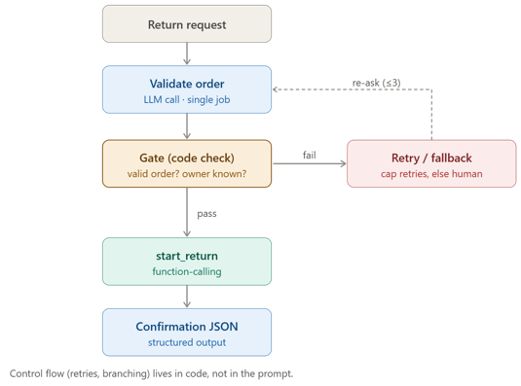
Sample Question : Case study - Scenario
4. Returns / refunds → prompt chaining with a gate. A short sequence of single-job calls: validate the order → call start_return → produce the confirmation JSON. A code gate between stages checks the process is still on track (valid order? owner known?) before continuing; on failure it re-asks, with a capped number of retries, then falls back.
5. Complaints / legal → escalation branch. No tool, no clever prompt — routed straight to a human queue with a short LLM-generated summary. This branch also catches anything outside the four intents (the router's safe default)

Slide 48
Sample Question : Case study - Scenario
(b) For each of the four intents, state which tool / path it uses, and explain why a router improves cost and reliability versus the single mega-prompt.
Ans:
Cost: the router is a small, cheap classifier that sends each query down the lightest path that can handle it — easy intents never invoke the large model, which the mega-prompt always did.
Reliability: separation of concerns. Each route is a short, single-job prompt that is independently testable, loggable, and swappable, so a failure points at one specific stage. In the mega-prompt, intent detection, tool use, and formatting were tangled in one call, so failures were opaque — you couldn't tell which part broke.
Intent | Path
Order tracking | function-calling — get_order_status
Returns / refunds | prompt chain → start_return + code gate
Product questions | function-calling — lookup_product(sku)
Complaints / legal | escalation to human queue

Slide 49
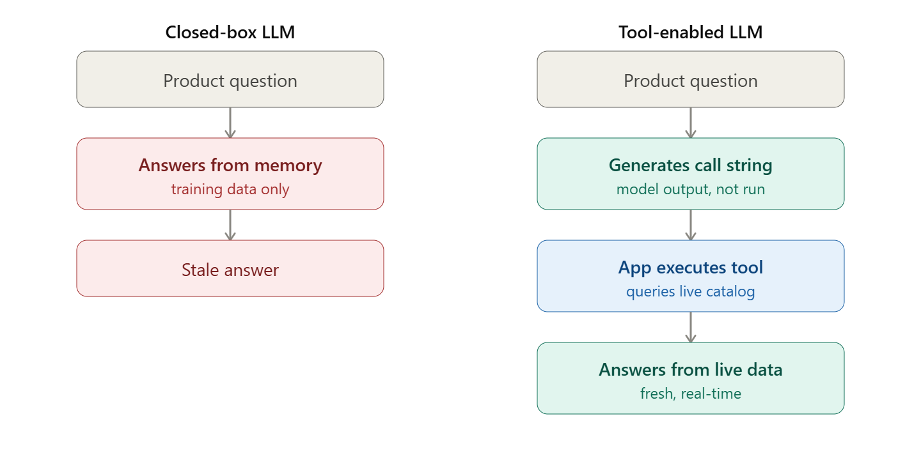
Sample Question : Case study - Scenario
(c) The product-question path must use the live database, not the model's memory. Using the closed-box vs tool-enabled distinction, explain what the model actually generates versus what executes, and how function-calling fixes the stale-data problem.
Ans: A standard LLM is closed-box: it only knows its training data, so it would answer product questions from stale memory. Function-calling makes it tool-enabled, and the key is the division of labour.

Slide 50
Sample Question : Case study - Scenario
The model only generates a function-call string — the tool name plus JSON arguments, e.g. lookup_product("SKU-X200"). It does not execute anything.
The application receives that string and runs the real database query (e.g. SELECT price, stock, specs FROM products WHERE sku = ?), then returns the structured row to the model, which composes the answer from that fresh result.
Tools aren't "installed" into the model — they're described to it; the model decides when to call, the app does the calling.
This fixes the stale-data problem because the answer is grounded in real-time data the app fetched, not whatever was frozen in the model's weights.
Optional : a keyed lookup needs the exact SKU, but the customer typed "the X200," not "SKU-X200." So add a resolve step first — the model normalises the SKU, or a small find_sku(name) call precedes lookup_product.

Slide 51
Sample Question : Case study - Scenario
(d) Give one concrete failure the router itself can introduce, and one safeguard against it.
Ans:
Failure: misrouting. Because the router is a cheap classifier, it can send a query to the wrong path — most dangerously, classifying a legal threat or churn-risk complaint as a routine question, so it never reaches a human.
Safeguard: have the router return a confidence score and default to the HUMAN route when confidence is low ("anything you are unsure about → HUMAN"). A semantic / embedding fallback router, or an audit of low-confidence routes, also helps catch systematic misrouting.

Slide 52
Summary
Design
Six components; delimit inputs; schema-first output; serialize tables deliberately
Paradigms
Zero/few-shot & ICL: demonstrations teach format & label space; self-consistency = sample & vote
System design
Chain small reliable calls; decompose queries; route by intent/difficulty; tools via function calling
Optimization
Prompts are hyperparameters: APE proposes & scores; OPRO optimizes in language; DSPy/GEPA compile pipelines
Structured output
Verify-retry → schema-enforced APIs → constrained decoding (validity by construction)
Reasoning
CoT gives scratch space; ToT searches; step-back abstracts; PAL delegates computation to code
Iteration
ReAct grounds reasoning in tool observations; reflection works only with external feedback
Test-time compute
Accuracy is now a budget knob: best-of-N, long CoT, thinking budgets, difficulty routing

Slide 53
References
https://platform.openai.com/docs/guides/function-calling
https://www.promptingguide.ai/techniques
https://8738733.fs1.hubspotusercontent-na1.net/hubfs/8738733/eBooks/Weaviate-Context-Engineering-ebook.pdf
https://ai.google.dev/gemini-api/docs/function-calling?example=meeting
Anthropic Prompt Engineering Guide
OpenAI Prompt Engineering Guide
Research papers
  A Survey of Context Engineering for Large Language Models
  Tree of Thoughts: Deliberate Problem Solving with Large Language Models
  LARGE LANGUAGE MODELS ARE HUMAN-LEVEL PROMPT ENGINEERS
  Unsupervised Question Decomposition for Question Answering
  LEAST-TO-MOST PROMPTING ENABLES COMPLEXREASONING IN LARGE LANGUAGE MODELS
  Table Meets LLM: Can Large Language Models Understand Structured Table Data? A Benchmark and Empirical Study
  A Prompt Pattern Catalog
  ICL as Implicit Bayesian Inference
  Calibrate Before Use
  REACT : SYNERGIZING REASONING AND ACTING INLANGUAGE MODELS
  Teaching LLMs to Self-Debug

